Slide 1
E-Commerce Sales Performance Analysis and Visualization using Python and Excel
Kunal Yadav - Roll No : 202410101150120
Divyansh Srivastava – Roll No : 202410101150090
IBM Faculty Collaboration

Slide 2
CONTENTS
Dataset Overview
Methodology
Key Visualizations
Insights & Recommendations
Challenges & Solutions
Conclusions & Next Steps
Summary

Slide 3
Dataset Overview
Source : Kaggle E-Commerce Data
Records : ~500,000 transactions
Fields : Order, Product, Customer, Country, Amount, Date

Slide 4
Methodology
Data cleaning/engineering in Python
Exploratory & advanced analytics
Export & dashboard in Excel

Slide 5
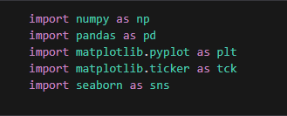

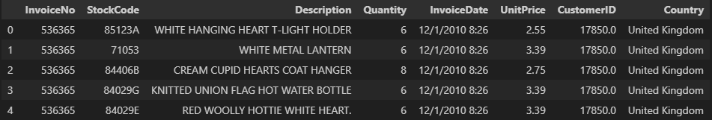
Reading The file
READ AND LOAD THE EXCEL DATA
INTO IPYNB FILE

Slide 6

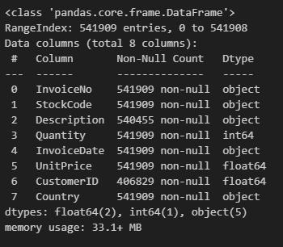
Dataframe structure summary
THE DF.INFO() OUTPUT SHOWS THE DATAFRAME’S STRUCTURE: IT HAS 541,909 ROWS AND 8 COLUMNS, LISTING EACH COLUMN’S NAME, NUMBER OF NON-NULL VALUES, AND DATA TYPE. THIS HELPS IDENTIFY COLUMNS WITH MISSING DATA (LIKE ‘DESCRIPTION’ AND ‘CUSTOMERID’), AND GIVES A QUICK OVERVIEW OF MEMORY USAGE AND DATA TYPES FOR FURTHER CLEANING OR ANALYSIS.

Slide 7
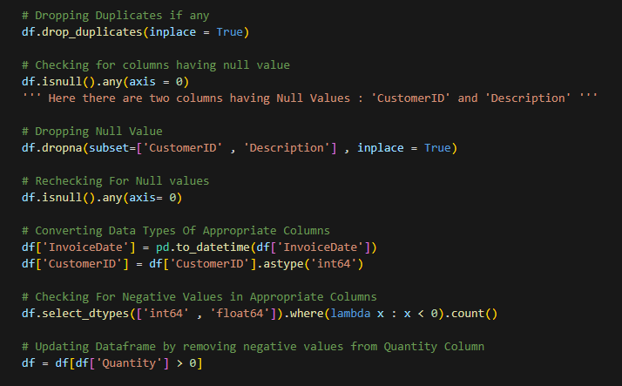
Cleaning data
THIS CODE CLEANS AND PREPROCESSES A DATASET BY REMOVING DUPLICATE, NULL, AND INVALID ENTRIES, CONVERTING DATA TYPES, AND ENSURING ALL QUANTITIES ARE POSITIVE. IT PREPARES THE DATAFRAME FOR ACCURATE ANALYSIS BY KEEPING ONLY VALID, CONSISTENT RECORDS.

Slide 8
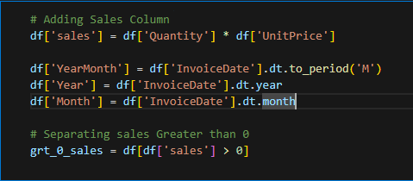
Adding columns
This code calculates total sales for each transaction, extracts year and month details from the invoice date, and then filters the dataset to include only records with positive sales values.

Slide 9
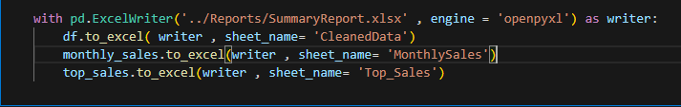
Adding columns
THIS CODE SAVES THE CLEANED DATA, MONTHLY SALES SUMMARY, AND TOP SALES RECORDS TO SEPARATE SHEETS IN A SINGLE EXCEL FILE NAMED SUMMARYREPORT.XLSX USING THE OPENPYXL ENGINE. EACH DATAFRAME IS WRITTEN TO ITS RELEVANT SHEET, MAKING IT EASY TO ORGANIZE AND ACCESS THE PROCESSED RESULTS IN ONE REPORT.

Slide 10
Key Visualizations
Monthly Sales Trend (Line)
Top Products (Bar)
Sales Distribution (Histogram)
Correlation Matrix (Heatmap)
Boxplot (spread by product/country)

Slide 11
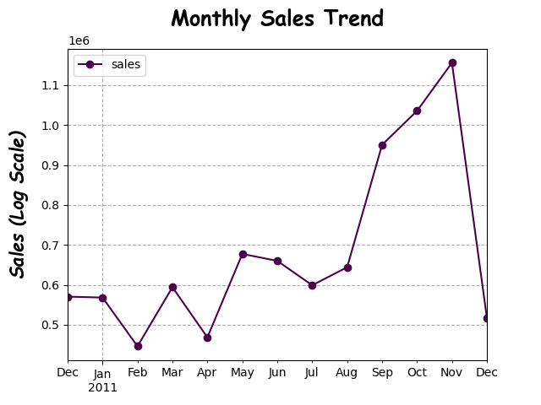
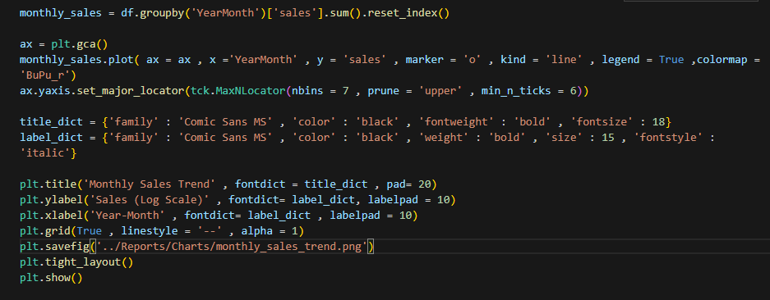
Monthly Sales Trend (Line)
Plots total sales for each month to highlight seasonality and business cycles.

Slide 12
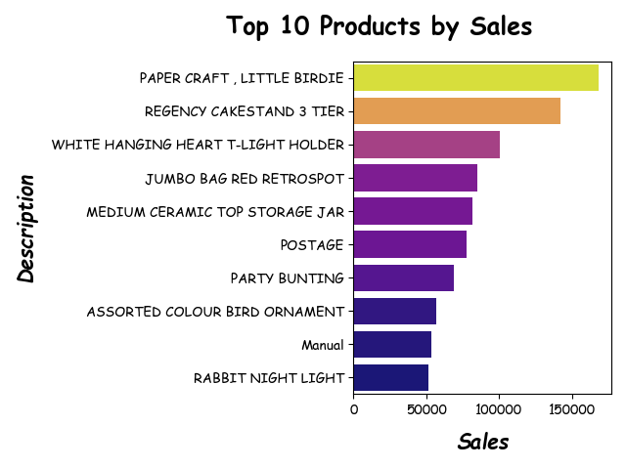
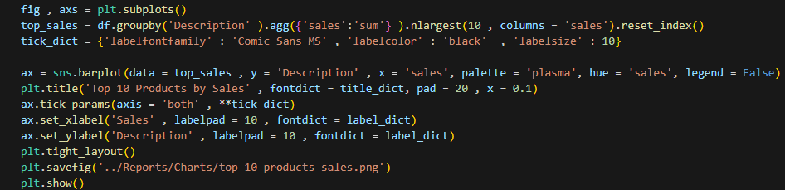
Top Products (Bar)
Displays the top-selling products, helping identify inventory and marketing priorities.

Slide 13
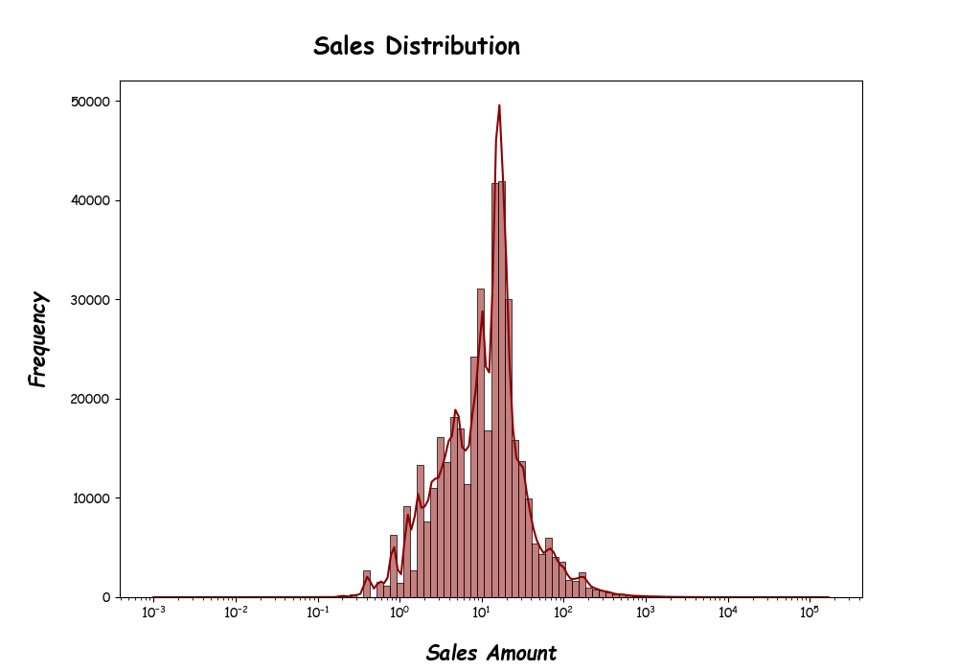
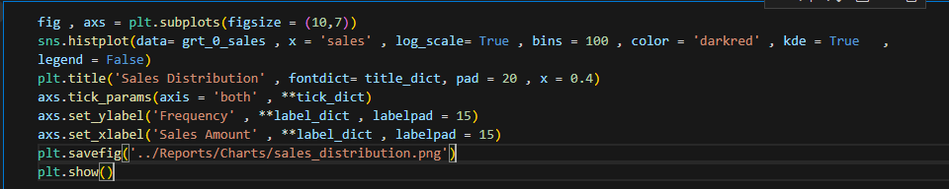
Sales Distribution (Histogram)
Shows how transaction amounts are spread, revealing skewness and outlier sales.

Slide 14
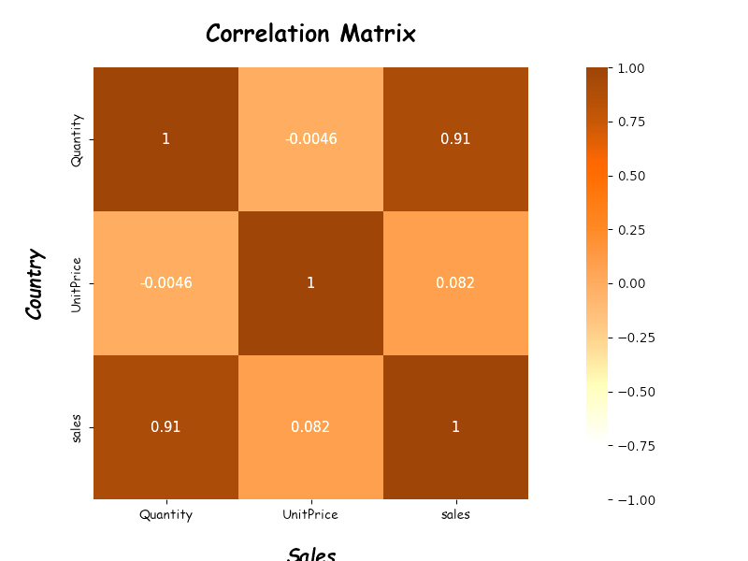
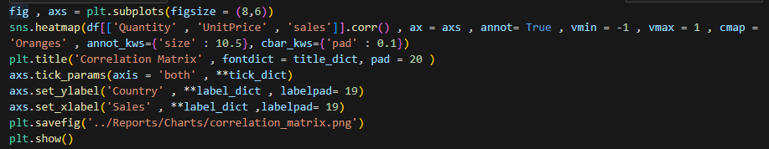
Correlation Matrix (Heatmap)
Visualizes relationships between quantity, price, and sales for analytical insights

Slide 15
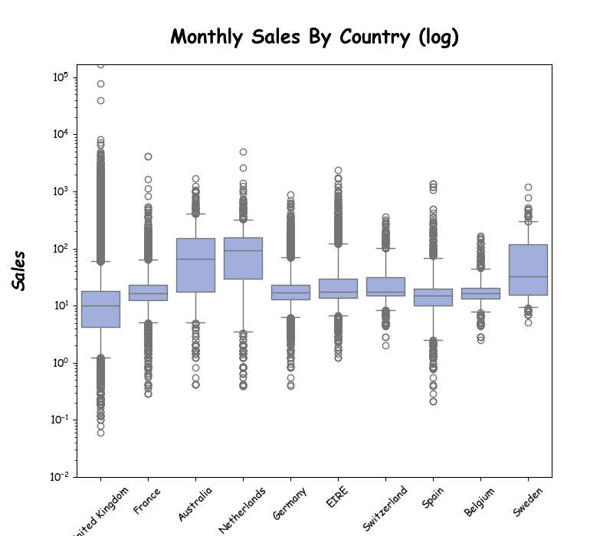
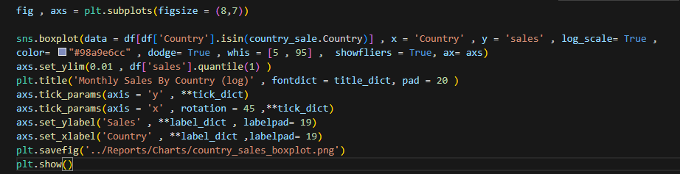
Boxplot (spread by product/country)
Illustrates the spread and variability of sales in each product or region group

Slide 16
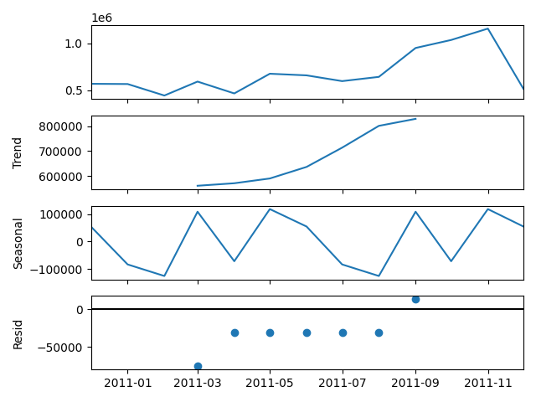
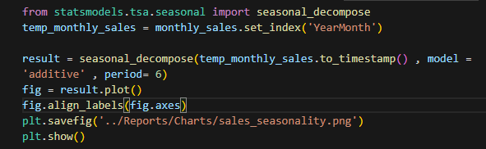
Time Trend Decomposition
Separates sales data into trend, seasonality, and residuals to reveal underlying business patterns.

Slide 17
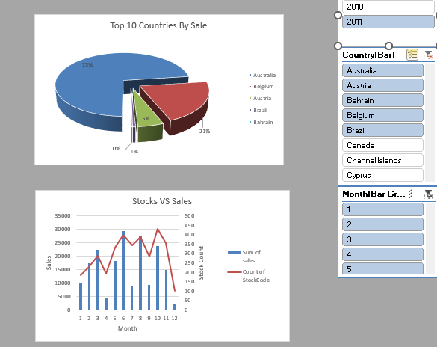
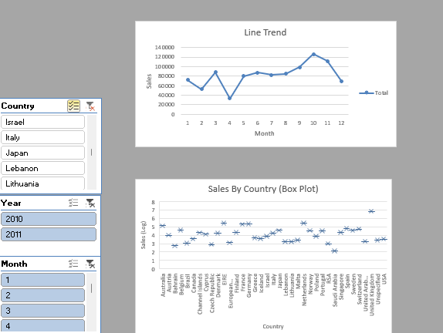
Dashboard Highlights
Easily filter sales by country or month using slicers.
Axis formats set to Lakhs; charts update automatically
Slicers
Slicers
Managers can identify monthly trends, top products, and regional performance at a glance

Slide 18
Insights & Recommendations
Strong seasonality – "Sales peak in holiday months; recommend targeted marketing during these periods."
Inventory optimization for top products – "High-selling items identified for stock prioritization."
Emerging opportunities in non-UK regions – "Significant sales growth seen in [Top 2] growing countries; suggest regional campaigns."
“Optimize marketing spend toward identified season peaks and invest in growing international markets”

Slide 19
Challenges & Solutions
Challenges
Solutions/Actions
Outliers and missing values introduced noise.
Visual mismatch between Python graphs and Excel charts
Slicers only controlled one chart or table; unable to filter across multiple data visualizations.
Box-and-whisker chart rendered as “X marks” due to single-value or identical data points in some groups
Applied rigorous filtering and imputation using Python Pandas.
Matched bin widths, axis scales, and custom color palettes for consistency
Manually configured slicer connections using "Report Connections" in Excel, enabling coordinated dashboard interactivity.
Increased data points and/or limited boxplot analysis to groups with sufficient data variation.

Slide 20
Conclusion & Next Steps
This workflow combines advanced Python analytics and Excel dashboards to deliver actionable business intelligence from large e-commerce datasets.
The provided templates can be expanded for other retail datasets or adapted to include machine learning forecasts.
Dashboards can be deployed for real-time monitoring or extended to cloud-based analytics platforms.
Enables data-driven decisions and aligns with industry reporting standards.

Slide 21
SUMMARY
Performed thorough data cleaning and advanced analysis on Kaggle e-commerce dataset.
Visualized major sales patterns, product trends, and regional performance.
Developed an interactive Excel dashboard for business insights.
Tackled data and visualization challenges with professional solutions.
Laid a solid foundation for ongoing analytics and reporting.

Slide 22



Thank you for your attention!
Questions and feedback are welcome
Kunal Yadav
Kunnuyadav18@gmail.com

